Slide 1
VETC Label Printing
| System Design | January, 2020

Slide 2
Content
Basic VETC Printing Information
Flow of 1st printing and 2nd printing
Requirement data for QR Code
ZPL error code
Zebra verification Permalocked (EPC) and Read User Memory

Slide 3
Basic VETC Printing Information
There 2 cycle of printing for VETC label
1st printing only required to print 8 digit of EPC no
2nd printing required to print QR code contains:-
i)Data1 (fixed value, provides by VETC)
ii) EPC (EPC Value)
iii) Data2 (fixed value, provides by VETC)
iv) CRC (calculate using the CCITT with 0x1021 polynomial )

Slide 4
Basic VETC Printing Information (Cont-)
Permalocked Status (EPC)
READ User Memory

Slide 5
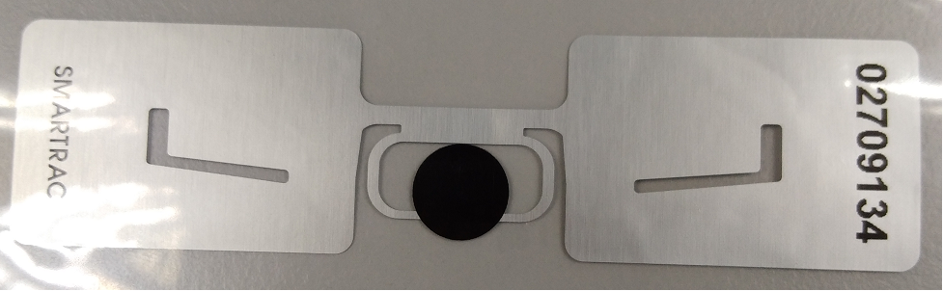
Select 1st printing process
1st printing process
Sample EPC no:
3416214B887D000002709146
3416214B88C9000002709147
3416214B88B1000002709148
START
Read Configuration File
initialize total print quantity
Key In Batch # & select product spec
Print Good Label
( last 8 digit of EPC)
Update Statistical Data at UI
and record data in logdata
Select employee no
Print VOID Label
Press button “START”
FAIL
PASS
Print qty <
spec qty?
Read EPC
Press button “FINISH”
YES
NO
ENCODE EPC
END
User
System

Slide 6
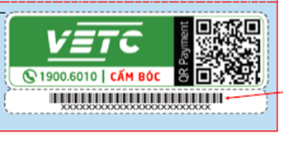
Select 2nd printing process
START
^{2st} printing process
Read Configuration File
initialize total print quantity
Print VOID Label
Key In Batch # & select product spec
Print Good Label (QR Code)
& 1D barcode (EPC) with text
Update Statistical Data at UI
and record data in logdata
Select employee no
PASS
READ user memory
Press button “START”
PASS
Print qty <
spec qty?
WRITE to EPC
with default #
FAIL
Press button “FINISH”
YES
NO
PASS
FAIL
Read EPC
END
User
System

Slide 7
Encode EPC
Prepare encoding files (placed at share folder)
1 printer will locked 1 encoding file
Name of encoding file will updated based on process, example
In Progress, Completed

Slide 8
DEFINE EPC DATA STRUCTURE
ZPL Command : ^RBn, p0,p1,p2,.....,p15
This command specifies the number of partitions and how many bits in each partition
PARAMETERS | DETAILS
n = total bits size of partitions | 1 to n (is the bit size of the tag) default :96
p0……p15 = partition sizes | Specify number of bits to include in the individual partitions. Partition size must add up to bit size specified for previous parameter. Largest individual partition size is 64 bits. Accepted values: 1 to 64 Default value : 1
^RB96,40,8,12,36

Slide 9
Read / Write RFID tag or specify access password
ZPL Command : ^RFo,f,b,n,m
PARAMETERS | DETAILS
o = operation | W = write to the tag R = read the tag S = specify access password
f = format | H = Hexadecimal A = ASCII E = EPC
b = password / starting block # | W = must be P and followed by access password ^FD command = 0 to n, starting block number R = 0 to n, starting block number S = must be P and followed by access password ^FD command
n = number of bytes to read or write | if format = E/A , this value not required else 1 to n(max number of byte for the tag)
m = memory bank | 0 = Reserved 1 = EPC 2 = TID (Tag ID) 3 = User
^XA
^RFR,H,R1,2,3^FS
^XZ

Slide 10
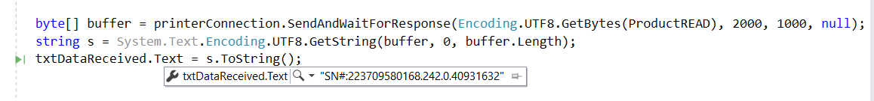
Read ZPL Command(TESTING)
^XA
^RS8,,,1,N^FS
^RB96,40,8,12,36^FS
^RMN^FNO^RFR,E^FS^HV0,,SN#:^XZ
SN#:223709580168.130.0.40931699
SN#:223709580168.62.0.40931697

Slide 11
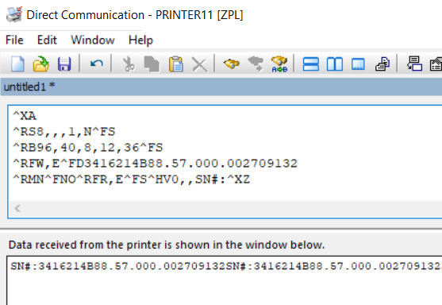
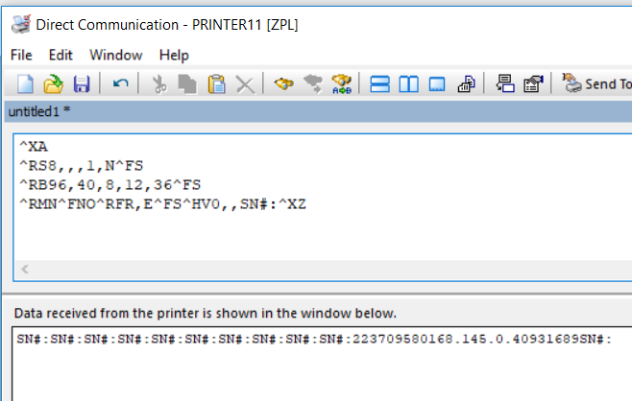

Slide 12
WRITE EPC
VETC Memory Block
EPC → write X value to EPC
→ if successfully WRITE , return result as FAIL
→ if unsuccessfully WRITE , return result as PASS
^XA
^RB96,40,8,12,36^FS
^RFW,E^Prefix.Key Index.Future Use.Serial Number^FS
^RFW,E^FD3416214B88.57.000.002709132^FS
^XZ

Slide 13
READ User Data Memory
VETC Memory Block
User data memory → read user memory / untraceable command
→ if successfully READ , return result as FAIL
→ if unsuccessfully READ , return result as PASS
^XA
^RFR,H,R1,2,3^FS
^XZ

Slide 14
QR CODE
ZPL Command : ^BQa,b,c,d,e
Data1 = 0002010102112614011001075004145204478453037045802VN5904
VETC6005HANOI610610000062620306vetc020624 (hardcode)
EPC = 3416214B8857000002709132
Data2 = 0708VETC00020808Nap Tien6304 (hardcode)
CRC = DB82
QR CODE = Data1 + EPC + Data2 + CRC
PARAMETERS | DETAILS
a = field orientation | Fixed value
b = model | 1 -> original 2 -> enhanced
c = magnification factor | 1 -> 150 dpi printers 2 -> 200 dpi printers 3 -> 300 dpi printers 6 on 600 dpi printers
d = H,Q,M,L | H -> ultra-high reliability level Q -> high reliability level M -> standard level L -> high density level
e = N,A,B,K | N -> Numeric A -> Alphanumeric B -> 8 bit byte mode K -> Kanji
^XA
^FO100,100
^BQa,2,6
^FDQA,<0002010102112614011001075004145204478453037045802VN5904VETC6005HANOI610610000062620306vetc020624
3416214B88570000027091320708VETC00020808Nap Tien6304 (hardcode)DB82>FS
^XZ

Slide 15
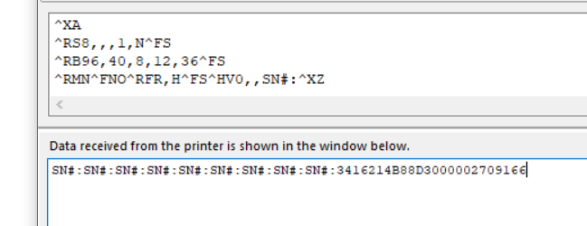
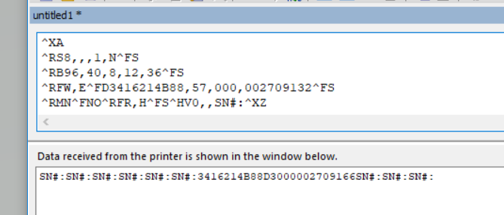
Read ZPL Command(TESTING)
Permalocked EPC
Write & READ ZPL Command(TESTING)

Slide 16
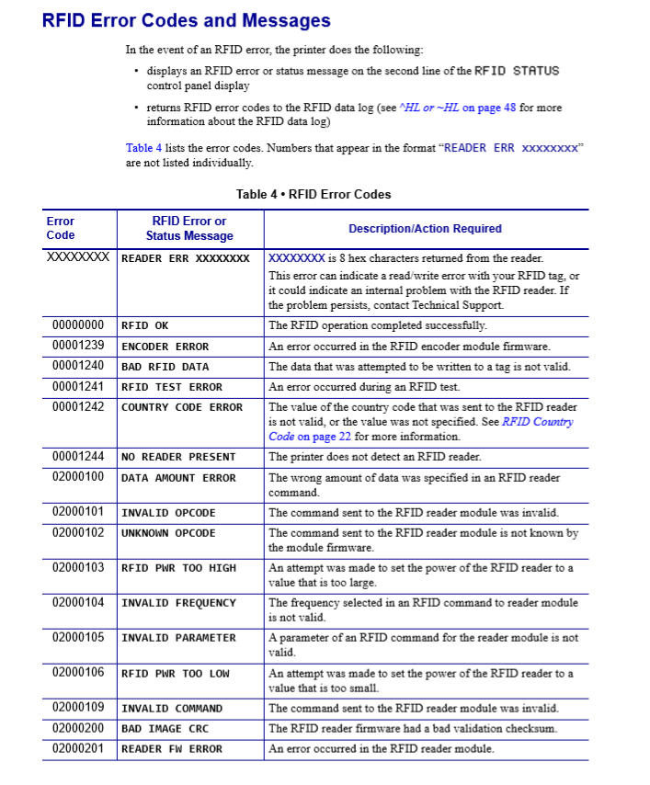
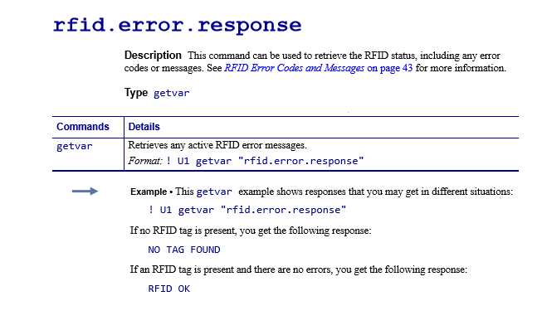

Slide 17
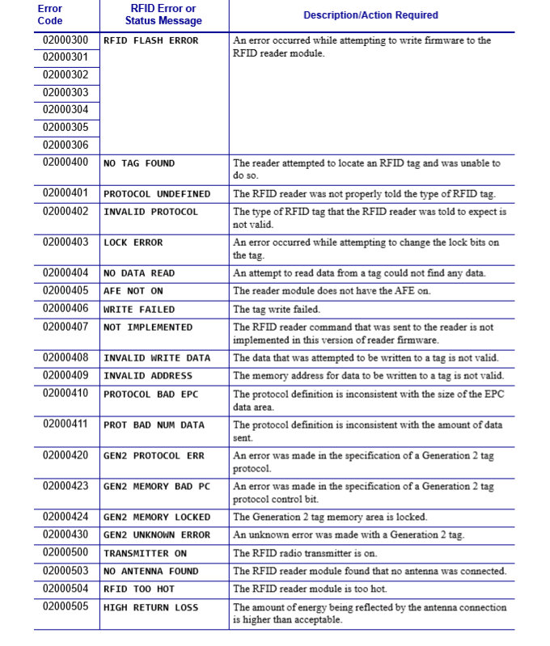
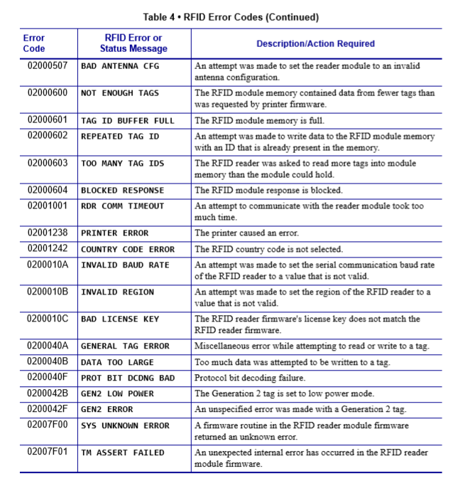

Slide 18
DATA MANAGEMENT
DM Zebra converter
- Fasters encode and printing process
Avoid system looping issue
User can pause printer without disturb queue
Can detect early abnormalities of data
On going to check / test
Max of print job queue
Write temp logfile (EPC / SN)
START
Run DM GENERATOR.exe
Run DM ZEBRA CONVERTER.exe
Generated DM files
Convert DM files to Zebra format and store at share folder
NO
YES
All files successful
generated?
All files successful
generated?
NO
YES
END

Slide 19
DATA MANAGEMENT - CONT
START
User fill in data in screen
User press button “START”
System check share folder , DM in zebra format file with naming _STARTED and replace with _INPROGRESS
END
Update temp DM in local ,transfer to share folder, replace original DM files
ENCODE / PRINTING
NO
YES
End of file?
Replace file name with _FINISH

